Slide 1
Presentation Lab3 : lab_fir
朱柏誠

Slide 2
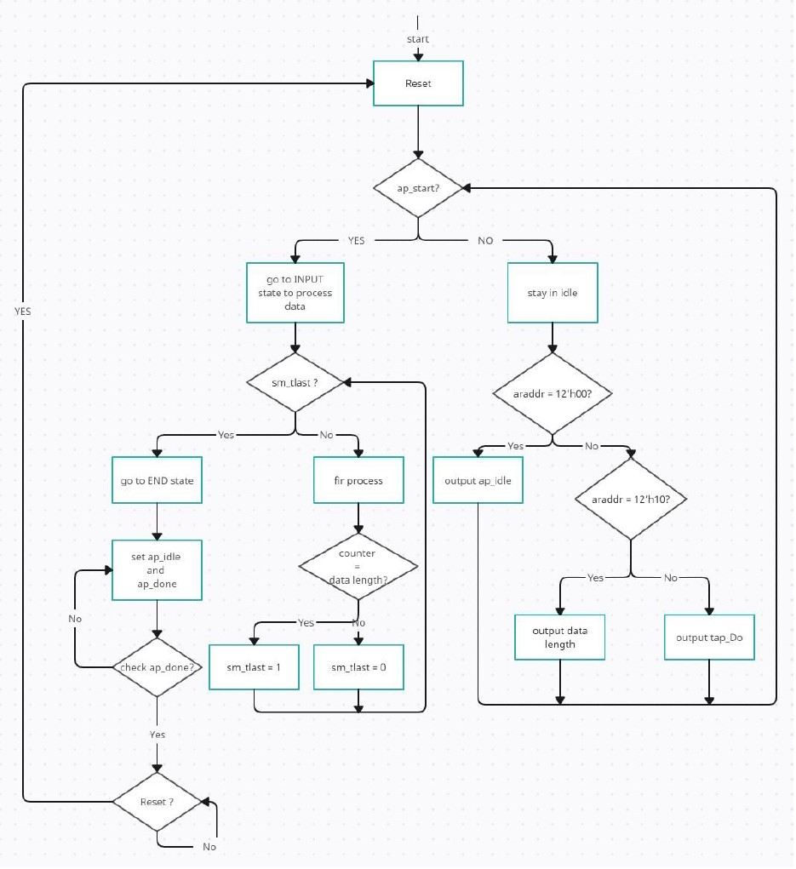
Flow

Slide 3
Tap WE ? Should qualify its address range MUL / ADD in one cycle ? X input latch ? Y output latch ?

Slide 4
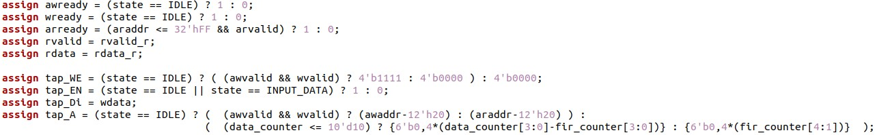
Tap WE
應使用wvalid和wready，再加上在wready的address decode判斷會更精準。

Slide 5
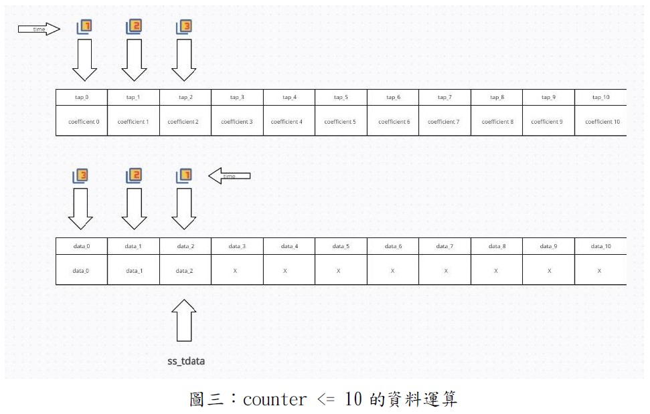
Should qualify its address range MUL / ADD in one cycle

Slide 6
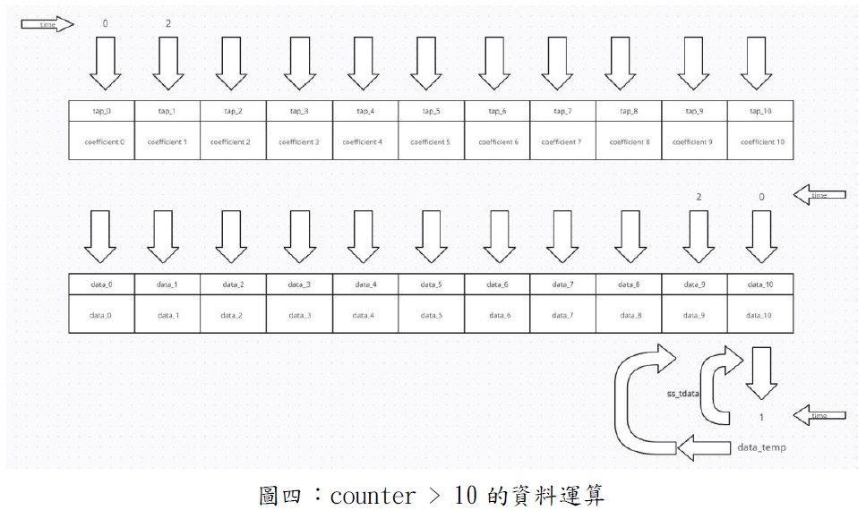
Should qualify its address range MUL / ADD in one cycle

Slide 7
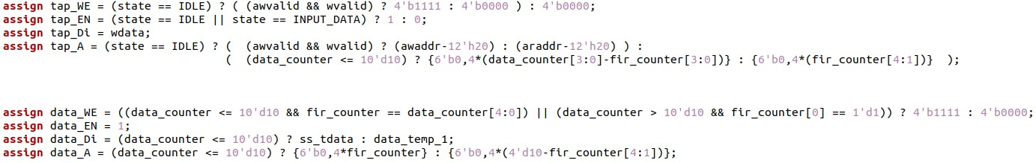
Should qualify its address range MUL / ADD in one cycle

Slide 8
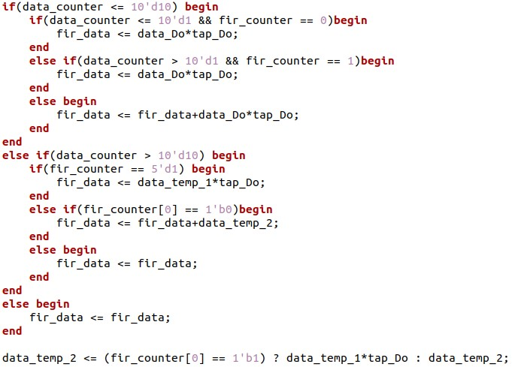
Should qualify its address range MUL / ADD in one cycle
應都設計為11或22個週期的計算，在速度和面積擇一，減少設計複雜度並同時增加硬體特性，另外在條件判斷上也會要使用額外面積。

Slide 9
X input latch ? Y output latch ?
Input有用data_temp暫存，output並無設計，應設計多一組控制訊號判斷是否讀取fir_data，若無讀取則將fir_counter計算到21就停止等待輸出後再歸零，在計算下一筆資料。

Slide 10
二是在data_bram被填滿後需要做shift的動作故總共需22個clock計算如圖四所示，在偶數個clock輸入要讀取之地址
=> Should use read/write pointer, instead of shift
LUT 321, FF – 146

Slide 11
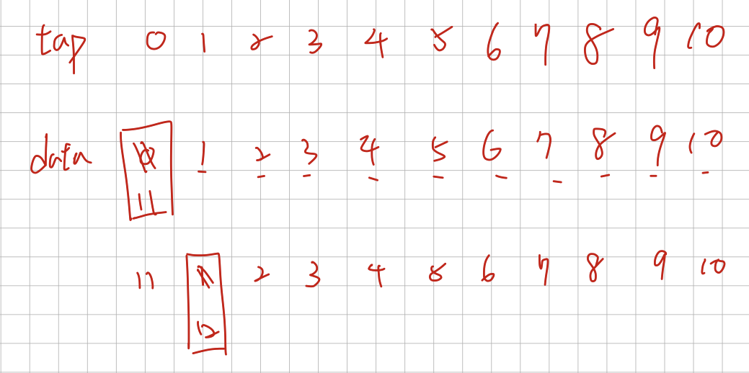
read/write pointer
若使用pointer，則在填滿data_ram後只需要11個cycle即可計算一筆資料
需另外設計pointer的起始位置

Slide 12
arready, rvalid can not constant 1
assign awready = (state == IDLE) ? 1 : 0;
assign wready = (state == IDLE) ? 1 : 0;
assign arready = 1'b1;
assign rvalid = 1'b1;
assign rdata = rdata_r;
rvalid_r <= (arready) ? 1 : 0;

Slide 13
Code review
- awaddr should qualified by awvalid
data_length <= (awaddr==12'h10) ? wdata : data_length;
data_length <= (awaddr==12'h10 && awvalid && awready) ? wdata : data_length;

Slide 14
rdata_r should consolidate in one place
rdata_r can be any location not depend on the state
always@(*)begin
case(state)
IDLE : begin
if(araddr==12'h00 && ap_idle) begin
rdata_r = {{{29'b0,ap_idle},ap_done},ap_start};
end
else if(araddr==12'h10) begin
rdata_r = data_length;
end
else begin
rdata_r = tap_Do;
end
ap_idle = 1;
ap_start = 0;
ap_done = 0;
next_state = (awaddr == 12'h00 && wdata == 32'h0000_0001 && ap_idle) ? INPUT_DATA : IDLE;
end
INPUT_DATA : begin
rdata_r = (araddr == 12'h00) ? {{{29'b0,ap_idle},ap_done},ap_start} : 0;
ap_idle = sm_tlast;
ap_start = (data_counter == 10'd0 && fir_counter == 5'd0) ? 1 : 0;
ap_done = (sm_tlast) ? 1 : 0;
next_state = (sm_tlast) ? END : INPUT_DATA;
end
END : begin
rdata_r = (araddr == 12'h00) ? {{{29'b0,ap_idle},ap_done},ap_start} : 0;
ap_idle = sm_tlast;
ap_start = 0;
ap_done = (read) ? 0:1;
next_state = END;
end
default : begin
rdata_r = 0;
ap_idle = 0;
ap_start = 0;
ap_done = 0;
next_state = IDLE;
end
endcase

Slide 15
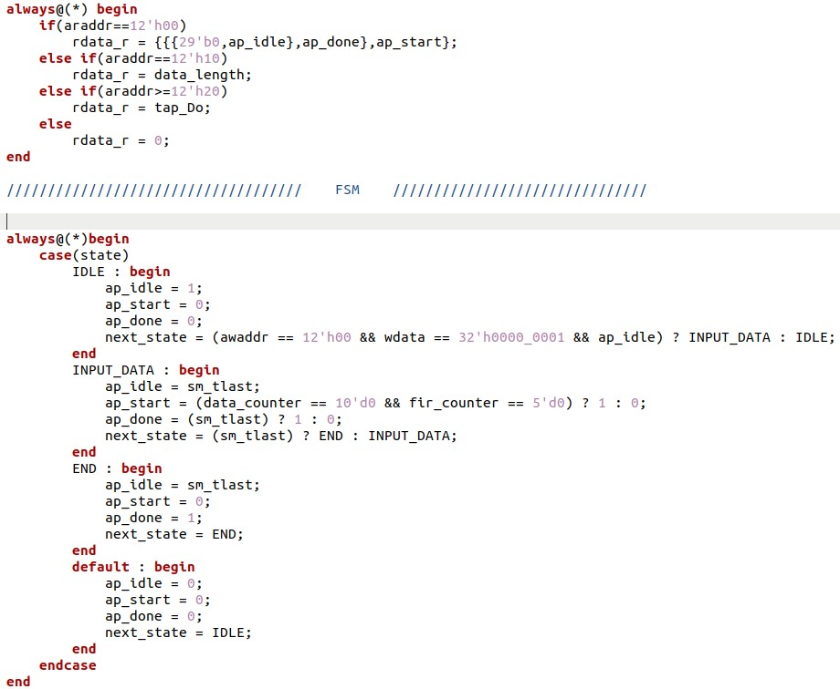
Code review

